Slide 1
UML Usecase and Class Diagrams
Slide Reference: Marty Stepp, 2007.

Slide 2
What is UML and Why we use UML?
UML → “Unified Modeling Language”
Language: express idea, not a methodology
Modeling: Describing a software system at a high level of abstraction
Unified: UML has become a world standard
Object Management Group (OMG): www.omg.org

Slide 3
What is UML and Why we use UML?
It is a industry-standard graphical language for specifying, visualizing, constructing, and documenting the artifacts of software systems
The UML uses mostly graphical notations to express the OO analysis and design of software projects.
Simplifies the complex process of software design

Slide 4
as a sketch: to communicate aspects of system
forward design: doing UML before coding
backward design: doing UML after coding as documentation
as a blueprint: a complete design to be implemented
sometimes done with CASE (Computer-Aided Software Engineering) tools
as a programming language: with the right tools, code can be auto-generated and executed from UML

Slide 5
What is UML and Why we use UML?
Year Version
2012: UML 2.5
2003: UML 2.0
2001: UML 1.4
1999: UML 1.3
1997: UML 1.0, 1.1
1996: UML 0.9 & 0.91
1995: Unified Method 0.8
Booch ‘93
OMT - 2
Other methods
Booch ‘91
OMT - 1

Slide 6
UML supported diagrams
class
package
deployment
use case
interaction
communication
sequence
collaboration
timing
activity
state/statechart

Slide 7
Brief Overview
class - set of classes, interfaces, collaboration, relationships
use case - description of functionality provided by system along with actors and their connection to the use case
interaction - set of objects and their relationships including messages

Slide 8
Overview (cont.)
state/statechart - a state machine showing states, transitions, events, and activities
activity - statechart sequential flow of activities
component - physical structure of code in terms of code components

Slide 9
Organization of Diagrams
domain expert
use case
activity
interaction
system designer
class
component
deployment
state
package

Slide 10
Use-Case Diagrams
A use-case diagram is a set of use cases
A use case is a model of the interaction between
External users of a software product (actors) and
The software product itself
More precisely, an actor is a user playing a specific role
describing a set of user scenarios
capturing user requirements
contract between end user and software developers

Slide 11
Use-Case Diagrams
Use Case
Boundary
Actor
Library System
Borrow
Employee
Client
Order Title
Fine Remittance
Supervisor

Slide 12
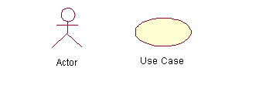
Use-Case Diagrams
Actors: A role that a user plays with respect to the system, including human users and other systems. e.g., inanimate physical objects (e.g. robot); an external system that needs some information from the current system.
Use case: A set of scenarios that describing an interaction between a user and a system, including alternatives.
System boundary: rectangle diagram representing the boundary between the actors and the system.

Slide 13
Use-Case Diagrams
Association:
communication between an actor and a use case; Represented by a solid line.
Generalization: relationship between one general use case and a special use case (used for defining special alternatives) Represented by a line with a triangular arrow head toward the parent use case.

Slide 14
Use-Case Diagrams
Include: a dotted line labeled <<include>> beginning at base use case and ending with an arrows pointing to the include use case. The include relationship occurs when a chunk of behavior is similar across more than one use case. Use “include” in stead of copying the description of that behavior.
<<include>>
Extend: a dotted line labeled <<extend>> with an arrow toward the base case. The extending use case may add behavior to the base use case. The base class declares “extension points”.
<<extend>>

Slide 15
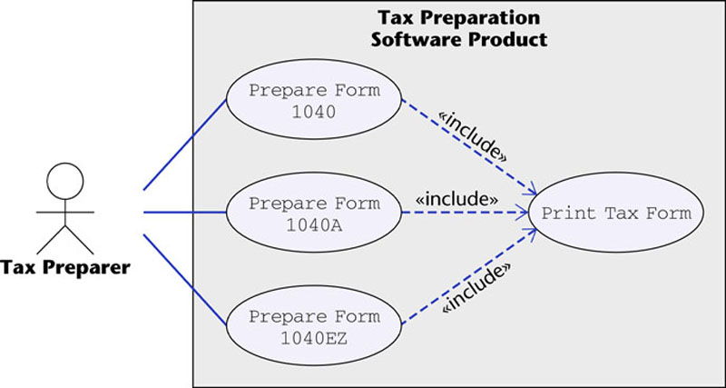
Use-Case Diagrams
The McGraw-Hill Companies, 2005
Figure 16.12

Slide 16
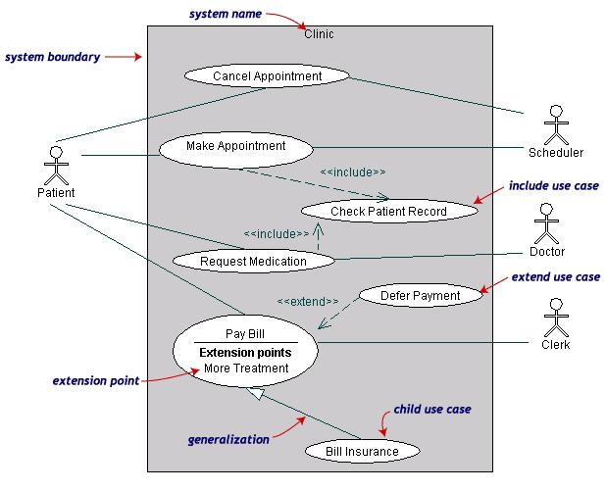
Use-Case Diagrams
Both Make Appointment and Request Medication include Check Patient Record as a subtask (include)
The extension point is written inside the base case Pay bill; the extending class Defer payment adds the behavior of this extension point. (extend)
Pay Bill is a parent use case and Bill Insurance is the child use case. (generalization)
(TogetherSoft, Inc)

Slide 17
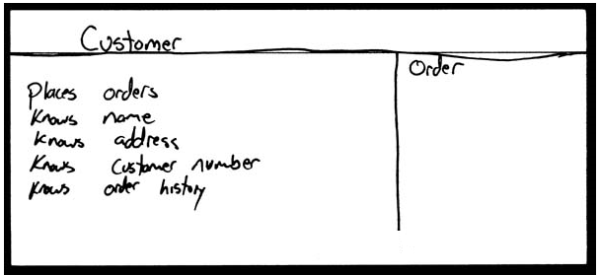
How do we design classes?
class identification from project spec / requirements
nouns are potential classes, objects, fields
verbs are potential methods or responsibilities of a class
Design the classes.

Slide 18
UML class diagrams
UML class diagram: a picture of the classes in an Object Oriented system, their fields and methods, and connections between the classes that interact or inherit from each other

Slide 19
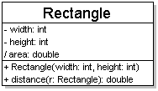
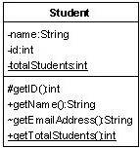
Diagram of one class
class name in top of box
write <<interface>> on top
of interfaces' names
use italics for an abstract class name
attributes (optional)
should include all fields of the object
operations / methods (optional)
may omit trivial (get/set) methods
should not include inherited methods

Slide 20
Class attributes
attributes (fields, instance variables)
visibility name : type [count] = default_value
visibility: + public # protected - private / derived
underline static attributes
derived attribute: not stored, but can be computed from other attribute values
attribute example: - balance : double = 0.00

Slide 21
Class operations / methods
operations / methods
visibility name (parameters) : return_type
visibility: + public # protected - private
underline static methods
parameter types listed as (name: type)
omit return_type on constructors and when return type is void
method example: + distance(p1: Point, p2: Point): double

Slide 22
Relationships btwn. classes
generalization: an inheritance relationship
inheritance between classes
interface implementation
association: a usage relationship
dependency
aggregation
composition

Slide 23
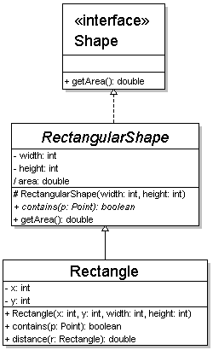
Generalization relationships
hierarchies drawn top-down with arrows pointing upward to parent
line/arrow styles differ, based on whether parent is a(n):
class: solid line, black arrow
abstract class: solid line, white arrow
interface: dashed line, white arrow

Slide 24
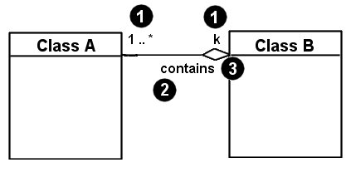
Associational relationships
1. multiplicity (how many are used)
* ⇒ 0, 1, or more
1 ⇒ 1 exactly
2..4 ⇒ between 2 and 4, inclusive
3..* ⇒ 3 or more
2. name (what relationship the objects have)
3. navigability
(direction)

Slide 25
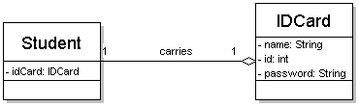
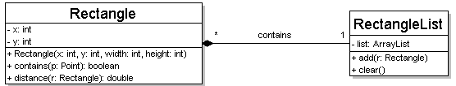
Multiplicity of associations
one-to-one
each student must carry exactly one ID card
one-to-many
one rectangle list can contain many rectangles

Slide 26
Association types
dependency:
HAS-A relationship
Expressed with relation name and direction
aggregation: "is part of"
symbolized by a clear white diamond
composition: "is entirely made of"
stronger version of aggregation
the parts live and die with the whole
symbolized by a black diamond
Car
1
1
aggregation
Engine
Book
composition
1
*
Page

Slide 27
Class diagram example 1
Multiplicity
Customer
1
Simple
Aggregation
Class
Class
Rental Invoice
Rental Item
1..*
1
0..1
Composition
Simple
Association
Generalization
Checkout Screen
DVD Movie
VHS Movie
Video Game

Slide 28
Thank You!!

